Slide 1




AI Farmer Assistant
Team Members
Florence C Tungoe
Anne Marie Rai
Dishari Dutta Chowdhury
Kakali Sarkar

Slide 2
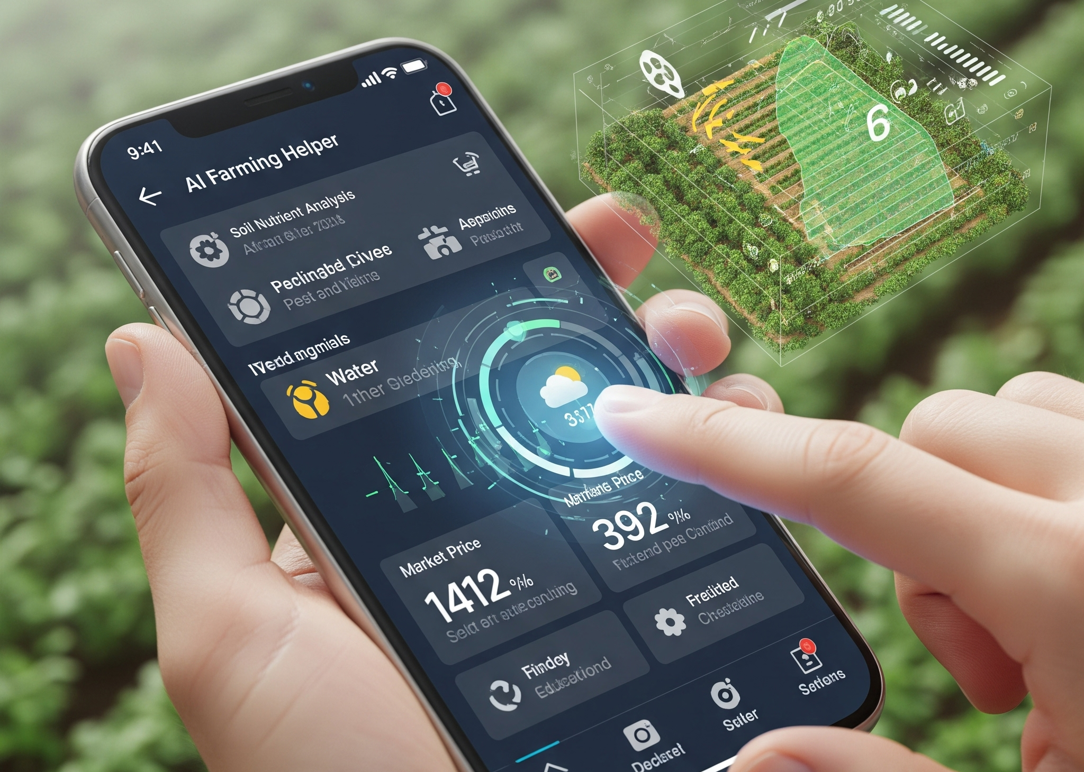
Problem Statement
Many farmers face significant barriers, including low literacy, limited access to expert agricultural advice, and a lack of appropriate digital tools. Furthermore, existing digital solutions are often too complex for this user base or are dependent on a stable internet connection, which is not always available in rural areas.

Slide 3
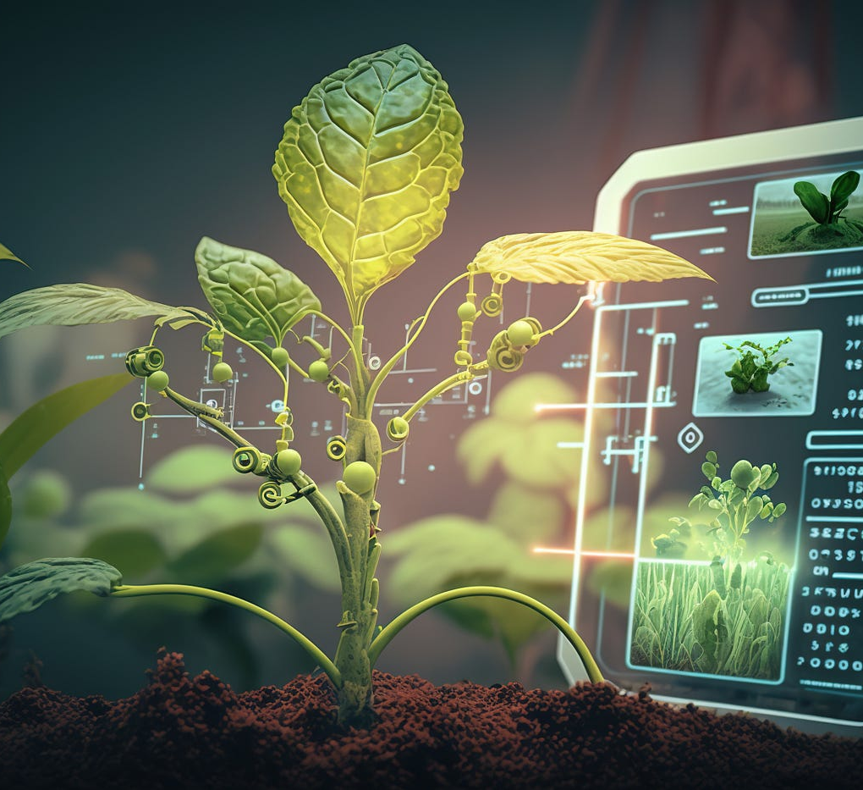
Solution
The proposed AI assistant for farmers is designed to overcome barriers such as low literacy and limited access to expert advice.
It will operate offline, making it suitable for rural areas with unreliable internet.
The assistant uses Computer Vision to detect crop diseases from images and Natural Language Processing to provide voice-guided advice.
It supports both Hindi and English languages and is built using Python and Streamlit.

Slide 4

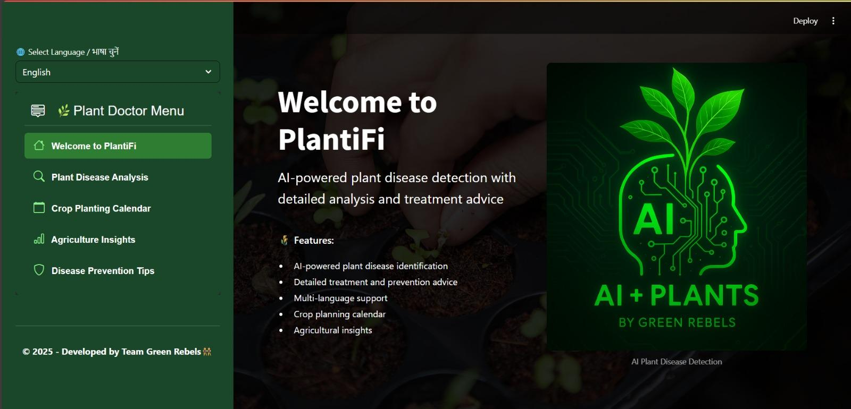
Project Demo
Capstone Project
Notes:
The demo showcases an AI-powered platform that provides NSTI trainees with:
Instant query support through AI chatbot
Personalized study material recommendations
Step-by-step problem-solving assistance
Real-time progress tracking and analytics
It ensures 24/7 academic support and enhances the overall learning experience.
The AI-powered NSTI Study Resource Helper provides verified study materials, understands trainee queries, adapts to learning styles, and updates content based on performance, ensuring personalized and effective skill-based education.
Demo website - NSTI Study Resource Helper | Microsoft Copilot Studio

Slide 5
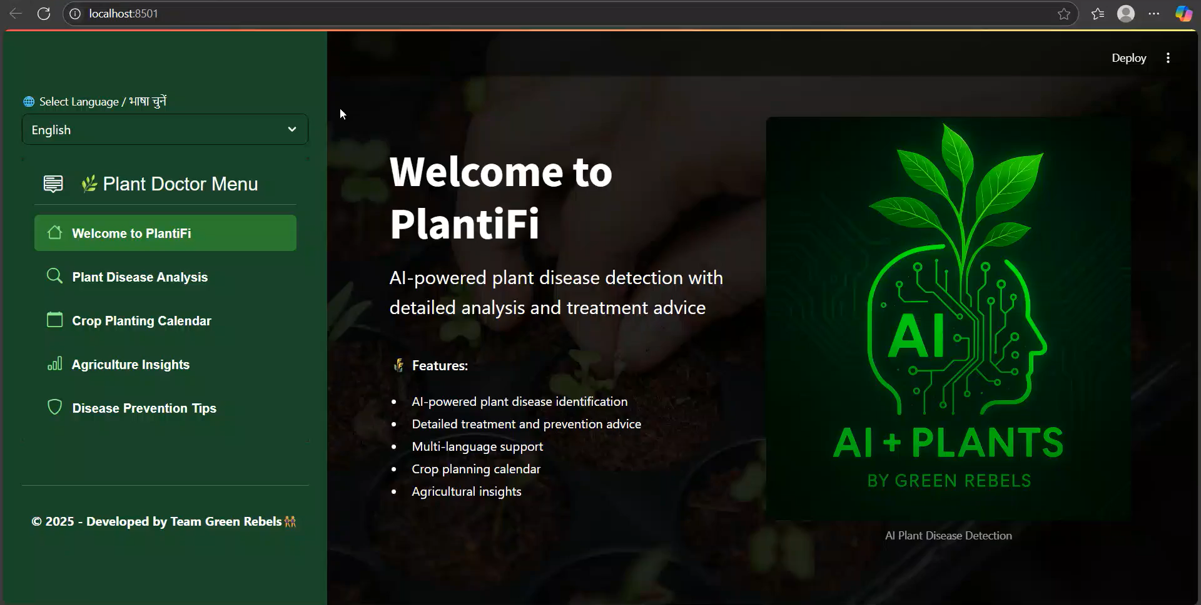
Project Video​

Slide 6
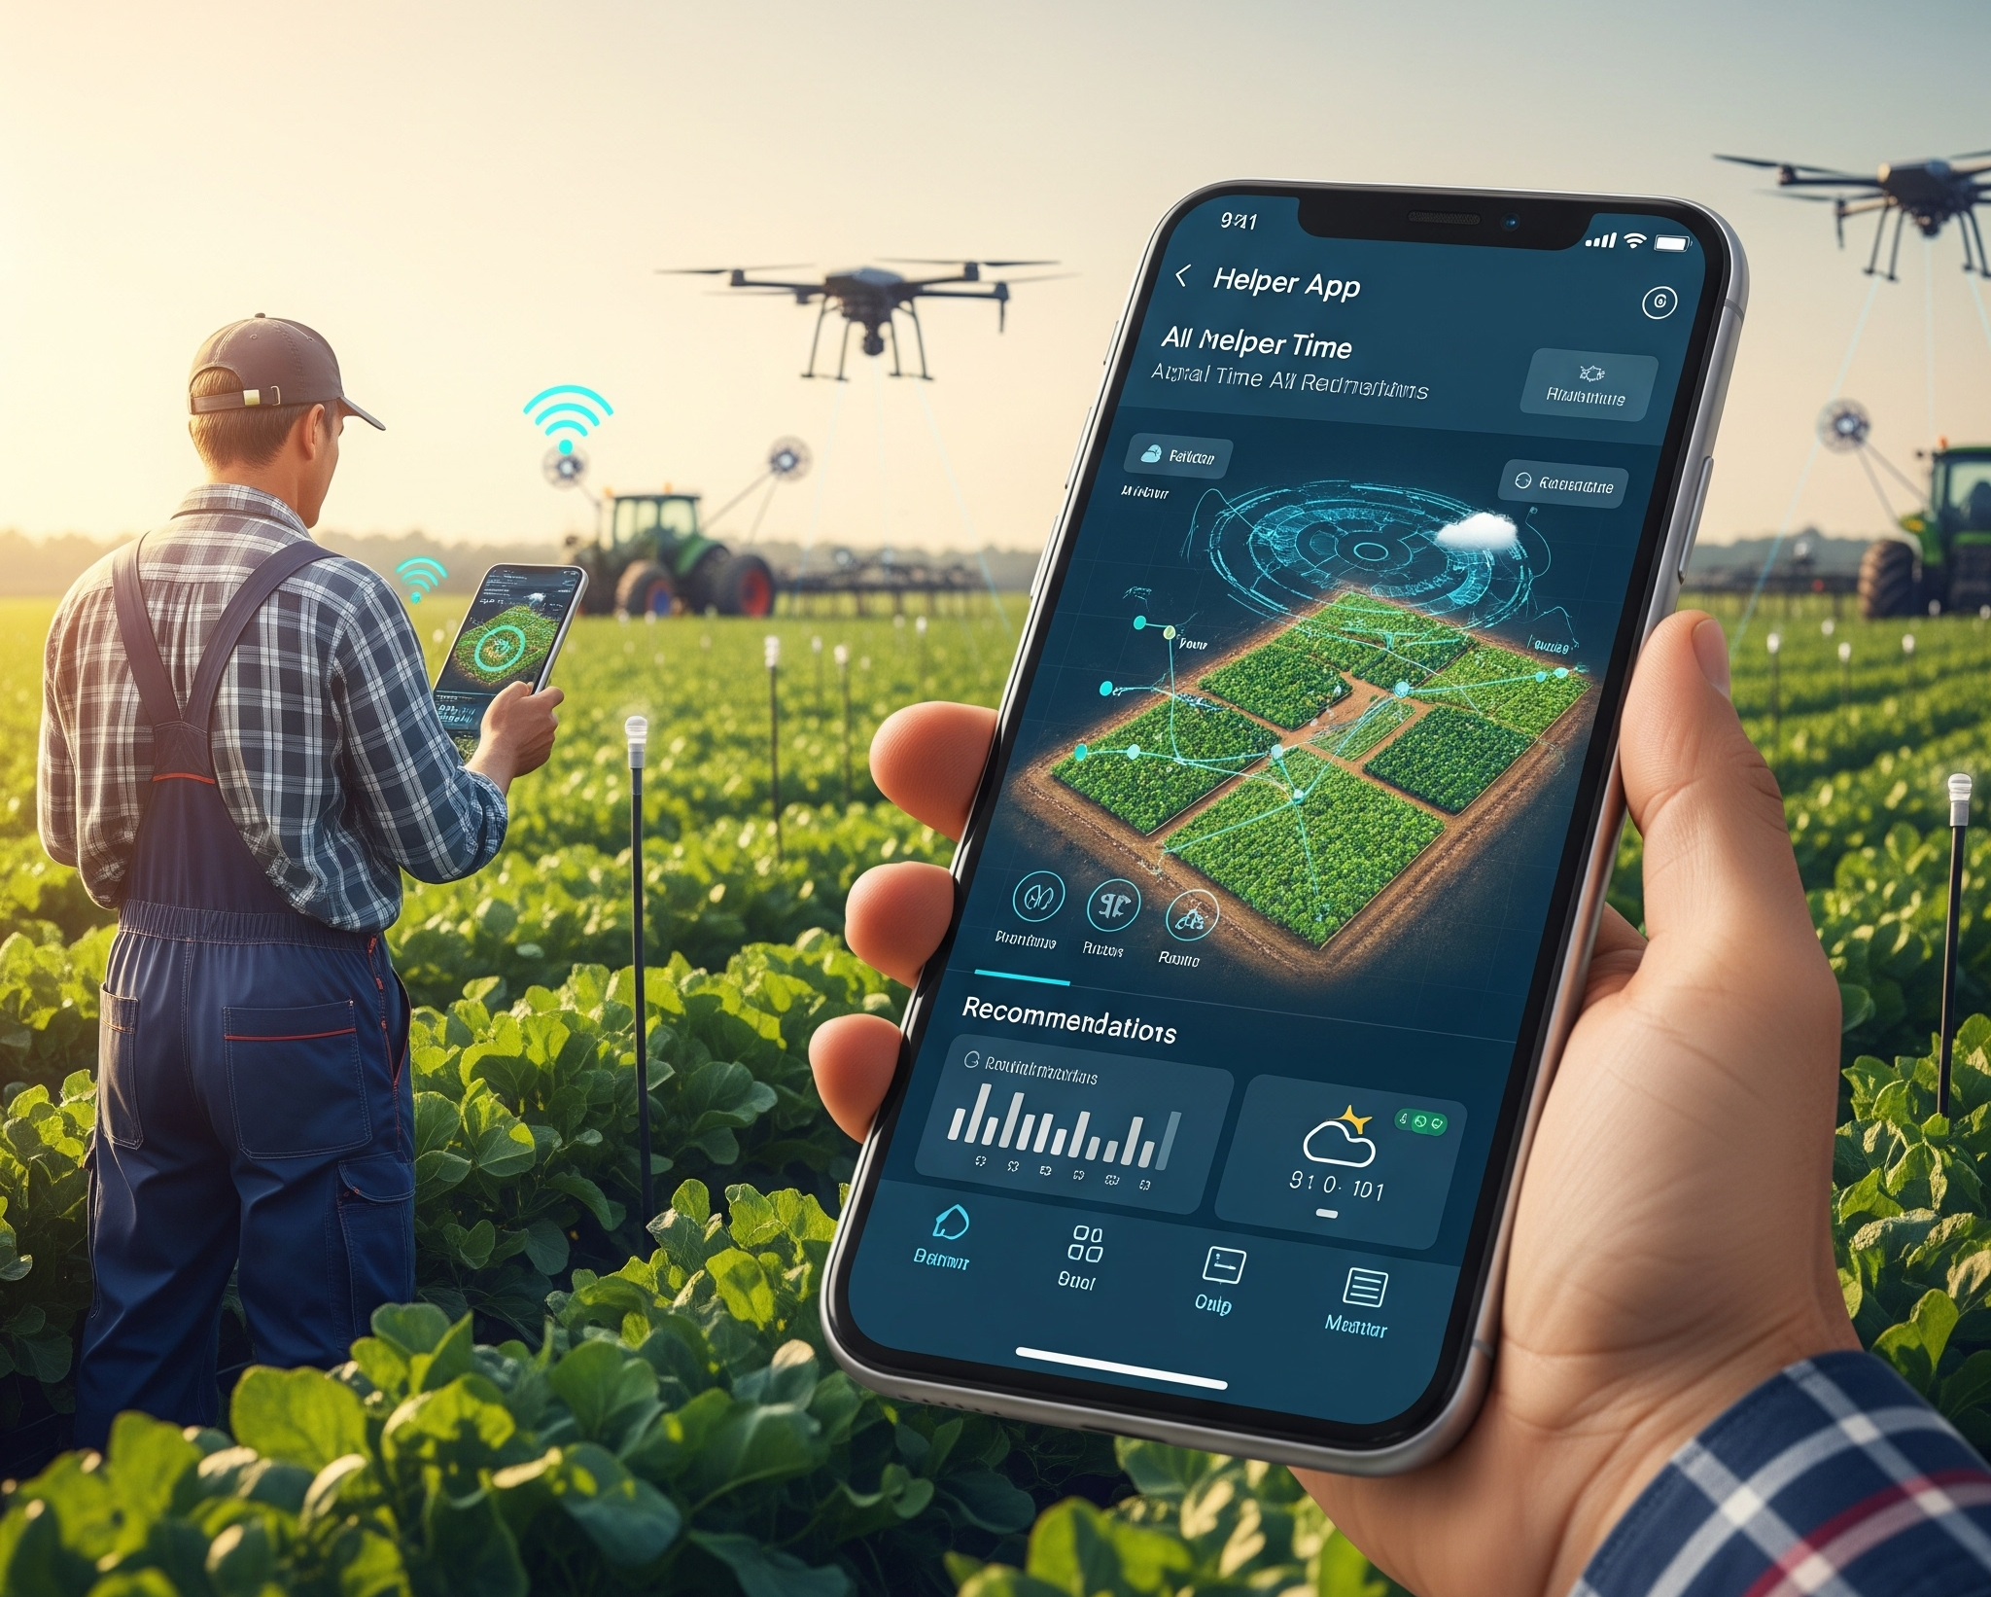
Future Scope
The application's future development focuses on transforming it into a more intelligent and comprehensive agricultural tool. Key enhancements include:
Voice-Activated Farming Assistant Multilingual voice interface for hands-free interaction. Offline voice support for low-connectivity regions.
Soil Health Analyzer Input or sync soil sensor data (pH, nutrients, moisture).Generate tailored soil treatment and crop recommendations.
Market Price Forecasting Tool Real-time and predictive market data for smarter crop sales. Visual dashboards for price trends and demand analysis.
Pest & Disease Outbreak Alerts Predict outbreaks using climate data and community reports. Early warnings with eco-friendly control strategies.

Slide 7
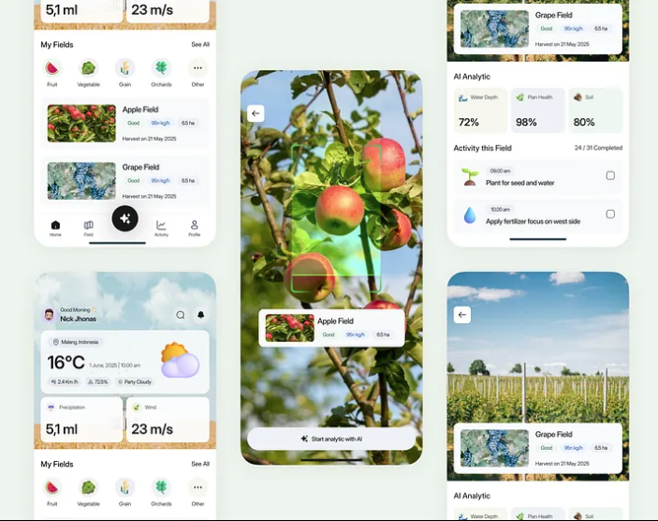
Conclusion
The AI Farmer Assistant is a versatile platform built to empower farmers with intelligent support. It offers diagnostic guidance for user-selected plant issues, which is seamlessly translated into English or Hindi and delivered through audio playback. The app also features a crop planting calendar and visually rich statistics on production and resource utilization, bringing together diagnostics, planning, and insights into one accessible and user-friendly interface.

Slide 8

Thank you!
Notes:
Reference
These are the references for this session.
8

